Slide 1

Sprocket Central Pty Ltd
Data analytics approach

Slide 2
Agenda
The approach will be implemented in two stages :
Data Exploration
Model Development

Slide 3
Agenda
Approach for Customer Data analysis :
Customer Segments by Wealth Segments
Avg Profit by State and Industry
Avg Profit by Age and Gender
Avg Sales per month
Customer Segments

Slide 4
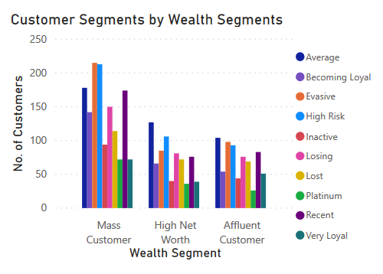
Data Exploration : Customer Segments by Wealth Segments
The mass customer segment has the highest number of customers.
Among all three wealth segments, we can observe that high-risk customers are predominant in each segment.
The mass customer wealth segment has the highest number of customers among all three segments.

Slide 5
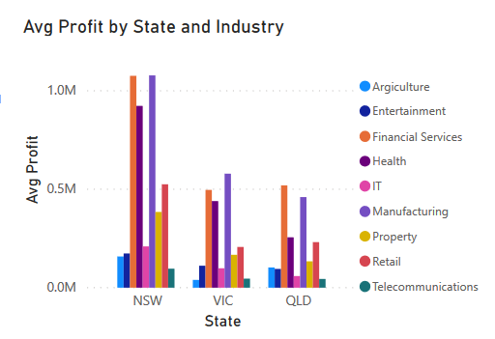
Data Exploration : Avg Profit by State and Industry
NSW has the highest average profit across all industries, followed by VIC and QLD.
The financial services, health, and manufacturing sectors have the highest average profit among all three states.

Slide 6
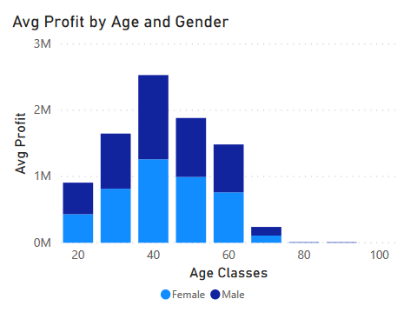
Data Exploration : Avg Profit by Age and Gender
All gender have an equal distribution in all age classes , with a approx 50%-50% split in each age class.
The age of approximately 40 is associated with the highest average profit.

Slide 7
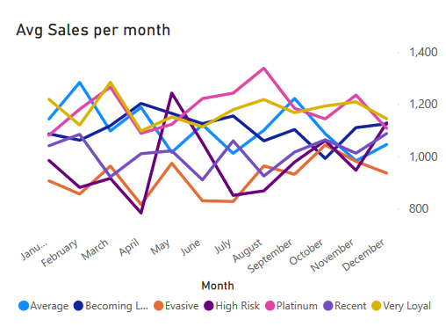
Data Exploration : Avg Sales per month
We can observe different categories of average sales per month.
High-risk customers experienced a significant increase in sales during May.
Platinum customers generally maintain a consistent average sales level throughout the year.

Slide 8
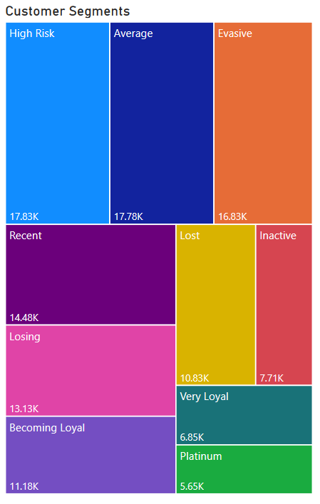
Data Exploration : Customer Segments
From the customer segments, it is evident that the high-risk segment has the highest number of customers, followed by the Average and Evasive segments.
The Platinum segment, which consistently maintains average sales throughout the year, has the lowest number of customers.

Slide 9
Model Development
CUSTOMER CLASSIFICATION – Targeting High Value Customers
The following are the high-value clients to target from the new list :
Aged between 40 – 50.
Most of the them are the Platinum customers.
Working in Financial Service, Manufacturing and Health.
Who are currently living in New South Wales.

Slide 10
Note: The data and information in this document is reflective of a hypothetical situation and client. This document is to be used for KPMG Virtual Internship purposes only.
THANK YOU

